Slide 1
Overview
Recursion
An algorithmic puzzle using recursion
Examples of recursion

Slide 2
What is Recursion
Sometimes, the best way to solve a problem is by solving a smaller version of the exact same problem first
Recursion is a technique that solves a problem by solving a smaller problem of the same type
In mathematics and computer science, recursion is a method of defining functions in which the function being defined is applied within its own definition
Recursion is much more readable, but consumes more memory
Iterative is not readable, but does not consume more memory
Recursion

Slide 3
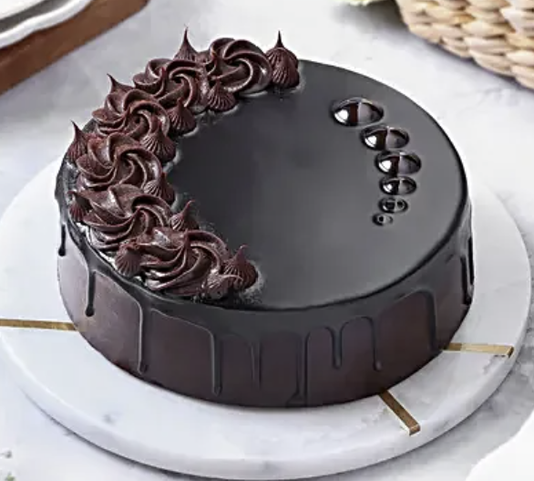

Cake Eating Problem
The cake is too huge to fit in your mouth — you can’t eat it all at once.

Slide 4
Cake Eating Problem
The cake is too huge to fit in your mouth — you can’t eat it all at once.
To finish it, you must cut it into smaller, manageable pieces first
— same structure, same taste.

Slide 5
Cake Eating Problem
Problem: The cake is too large to eat in one go.
Recursive Approach:
Slice the cake into a smaller piece → repeat on the smaller piece. (Recursive Step)
When the slice is bite-sized, just eat it — no more slicing needed. (Base Case)
Insight: Each slice is a smaller version of the same cake —same structure, same taste — perfect for recursion.

Slide 6
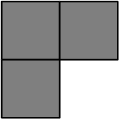
Tromino cover
Tromino cover: A right tromino is an L-shaped tile formed by three adjacent squares.
Figure: Rezaul A. Chowdhury, CSE 373, 2014
An algorithmic puzzle

Slide 7
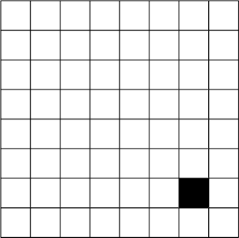
Tromino cover
Puzzle: You are given a 2^{n} ×2^{n} board
with one missing square.
you must cover all squares except the missing one exactly using right number of trominoes
the trominoes must not overlap
Figure: Rezaul A. Chowdhury, CSE 373, 2014
An algorithmic puzzle

Slide 8
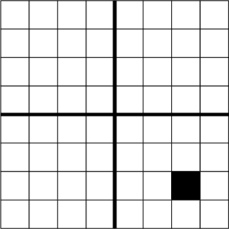
Tromino cover
Steps:
Divide the 2^{n} × 2^{n} board into 4 disjoint 2^{n−1} × 2^{n−1} subboards
Figure: Rezaul A. Chowdhury, CSE 373, 2014
An algorithmic puzzle

Slide 9
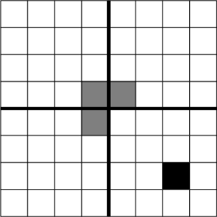
Tromino cover
Steps:
Divide the 2^{n} × 2^{n} board into 4
disjoint 2^{n−1} × 2^{n−1} subboards
Place a tromino at the center so that it fully covers one square from each of the three ( 3 ) subboards with no missing square, and misses the fourth subboard completely. This reduces the original problem into 4 smaller instances of the same problem!
Figure: Rezaul A. Chowdhury, CSE 373, 2014
An algorithmic puzzle

Slide 10
Tromino cover
Steps:
Divide the 2^{n} × 2^{n} board into 4 disjoint 2^{n−1} × 2^{n−1} subboards
Place a tromino at the center so that it fully covers one square from each of the three ( 3 ) subboards with no missing square, and misses the fourth subboard completely. This reduces the original problem into 4 smaller instances of the same problem!
Solve each smaller subproblem recursively using the same technique.
Figure: Rezaul A. Chowdhury, CSE 373, 2014
An algorithmic puzzle

Slide 11
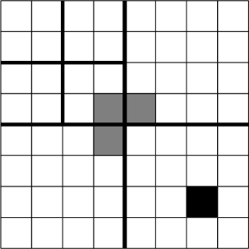
Tromino cover
Steps:
Divide the 2^{n} × 2^{n} board into 4 disjoint 2^{n−1} × 2^{n−1} subboards
Place a tromino at the center so that it fully covers one square from each of the three ( 3 ) subboards with no missing square, and misses the fourth subboard completely. This reduces the original problem into 4 smaller instances of the same problem!
Solve each smaller subproblem recursively using the same technique.
An algorithmic puzzle
Figure: Rezaul A. Chowdhury, CSE 373, 2014
8/44

Slide 12
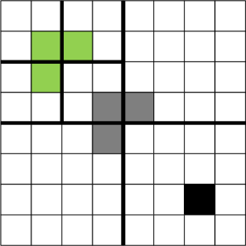
Tromino cover
Steps:
Divide the 2^{n} × 2^{n} board into 4 disjoint 2^{n−1} × 2^{n−1} subboards
Place a tromino at the center so that it fully covers one square from each of the three ( 3 ) subboards with no missing square, and misses the fourth subboard completely. This reduces the original problem into 4 smaller instances of the same problem!
Solve each smaller subproblem recursively using the same technique.
An algorithmic puzzle
Figure: Rezaul A. Chowdhury, CSE 373, 2014
9/44

Slide 13
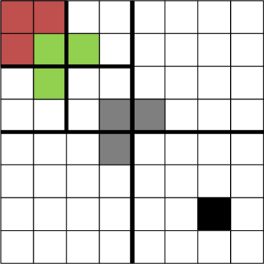
Tromino cover
Steps:
Divide the 2^{n} × 2^{n} board into 4 disjoint 2^{n−1} × 2^{n−1} subboards
Place a tromino at the center so that it fully covers one square from each of the three ( 3 ) subboards with no missing square, and misses the fourth subboard completely. This reduces the original problem into 4 smaller instances of the same problem!
Solve each smaller subproblem recursively using the same technique.
An algorithmic puzzle
Figure: Rezaul A. Chowdhury, CSE 373, 2014
10/44

Slide 14
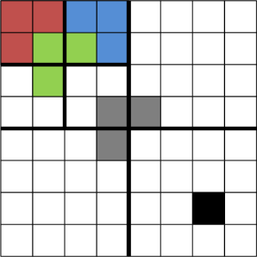
Tromino cover
Steps:
Divide the 2^{n} × 2^{n} board into 4 disjoint 2^{n−1} × 2^{n−1} subboards
Place a tromino at the center so that it fully covers one square from each of the three ( 3 ) subboards with no missing square, and misses the fourth subboard completely. This reduces the original problem into 4 smaller instances of the same problem!
Solve each smaller subproblem recursively using the same technique.
An algorithmic puzzle
Figure: Rezaul A. Chowdhury, CSE 373, 2014
11/44

Slide 15
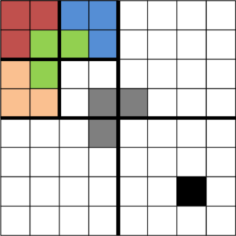
Tromino cover
Steps:
Divide the 2^{n} × 2^{n} board into 4 disjoint 2^{n−1} × 2^{n−1} subboards
Place a tromino at the center so that it fully covers one square from each of the three ( 3 ) subboards with no missing square, and misses the fourth subboard completely. This reduces the original problem into 4 smaller instances of the same problem!
Solve each smaller subproblem recursively using the same technique.
An algorithmic puzzle
Figure: Rezaul A. Chowdhury, CSE 373, 2014
12/44

Slide 16
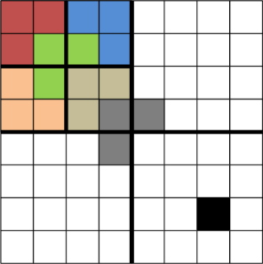
Tromino cover
Steps:
Divide the 2^{n} × 2^{n} board into 4 disjoint 2^{n−1} × 2^{n−1} subboards
Place a tromino at the center so that it fully covers one square from each of the three ( 3 ) subboards with no missing square, and misses the fourth subboard completely. This reduces the original problem into 4 smaller instances of the same problem!
Solve each smaller subproblem recursively using the same technique.
An algorithmic puzzle
Figure: Rezaul A. Chowdhury, CSE 373, 2014
13/44

Slide 17
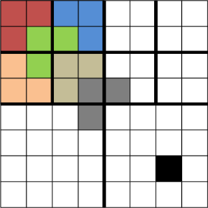
Tromino cover
Steps:
Divide the 2^{n} × 2^{n} board into 4 disjoint 2^{n−1} × 2^{n−1} subboards
Place a tromino at the center so that it fully covers one square from each of the three ( 3 ) subboards with no missing square, and misses the fourth subboard completely. This reduces the original problem into 4 smaller instances of the same problem!
Solve each smaller subproblem recursively using the same technique.
An algorithmic puzzle
Figure: Rezaul A. Chowdhury, CSE 373, 2014
14/44

Slide 18
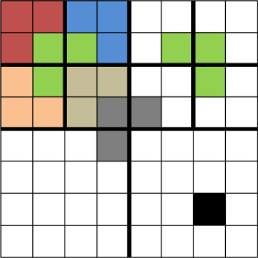
Tromino cover
Steps:
Divide the 2^{n} × 2^{n} board into 4 disjoint 2^{n−1} × 2^{n−1} subboards
Place a tromino at the center so that it fully covers one square from each of the three ( 3 ) subboards with no missing square, and misses the fourth subboard completely. This reduces the original problem into 4 smaller instances of the same problem!
Solve each smaller subproblem recursively using the same technique.
An algorithmic puzzle
Figure: Rezaul A. Chowdhury, CSE 373, 2014
15/44

Slide 19
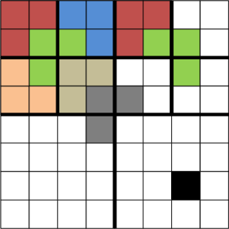
Tromino cover
Steps:
Divide the 2^{n} × 2^{n} board into 4 disjoint 2^{n−1} × 2^{n−1} subboards
Place a tromino at the center so that it fully covers one square from each of the three ( 3 ) subboards with no missing square, and misses the fourth subboard completely. This reduces the original problem into 4 smaller instances of the same problem!
Solve each smaller subproblem recursively using the same technique.
An algorithmic puzzle
Figure: Rezaul A. Chowdhury, CSE 373, 2014
16/44

Slide 20
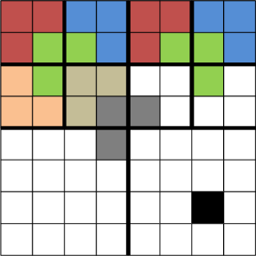
Tromino cover
Steps:
Divide the 2^{n} × 2^{n} board into 4 disjoint 2^{n−1} × 2^{n−1} subboards
Place a tromino at the center so that it fully covers one square from each of the three ( 3 ) subboards with no missing square, and misses the fourth subboard completely. This reduces the original problem into 4 smaller instances of the same problem!
Solve each smaller subproblem recursively using the same technique.
An algorithmic puzzle
Figure: Rezaul A. Chowdhury, CSE 373, 2014
17/44

Slide 21
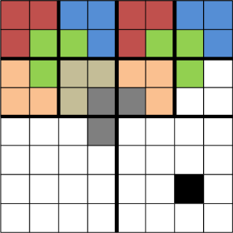
Tromino cover
Steps:
Divide the 2^{n} × 2^{n} board into 4 disjoint 2^{n−1} × 2^{n−1} subboards
Place a tromino at the center so that it fully covers one square from each of the three ( 3 ) subboards with no missing square, and misses the fourth subboard completely. This reduces the original problem into 4 smaller instances of the same problem!
Solve each smaller subproblem recursively using the same technique.
An algorithmic puzzle
Figure: Rezaul A. Chowdhury, CSE 373, 2014
18/44

Slide 22
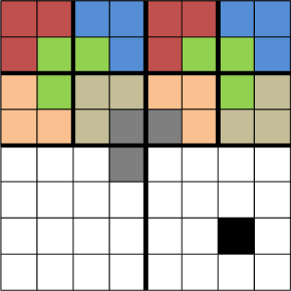
Tromino cover
Steps:
Divide the 2^{n} × 2^{n} board into 4 disjoint 2^{n−1} × 2^{n−1} subboards
Place a tromino at the center so that it fully covers one square from each of the three ( 3 ) subboards with no missing square, and misses the fourth subboard completely. This reduces the original problem into 4 smaller instances of the same problem!
Solve each smaller subproblem recursively using the same technique.
An algorithmic puzzle
Figure: Rezaul A. Chowdhury, CSE 373, 2014
19/44

Slide 23
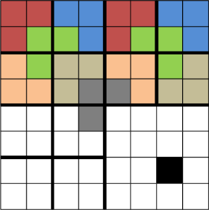
Tromino cover
Steps:
Divide the 2^{n} × 2^{n} board into 4 disjoint 2^{n−1} × 2^{n−1} subboards
Place a tromino at the center so that it fully covers one square from each of the three ( 3 ) subboards with no missing square, and misses the fourth subboard completely. This reduces the original problem into 4 smaller instances of the same problem!
Solve each smaller subproblem recursively using the same technique.
An algorithmic puzzle
Figure: Rezaul A. Chowdhury, CSE 373, 2014
20/44

Slide 24
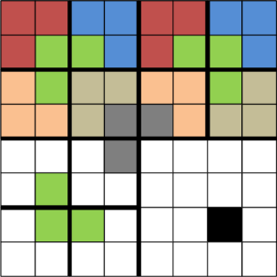
Tromino cover
Steps:
Divide the 2^{n} × 2^{n} board into 4 disjoint 2^{n−1} × 2^{n−1} subboards
Place a tromino at the center so that it fully covers one square from each of the three ( 3 ) subboards with no missing square, and misses the fourth subboard completely. This reduces the original problem into 4 smaller instances of the same problem!
Solve each smaller subproblem recursively using the same technique.
An algorithmic puzzle
Figure: Rezaul A. Chowdhury, CSE 373, 2014
21/44

Slide 25
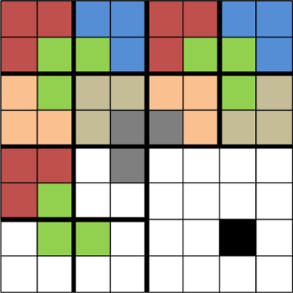
Tromino cover
Steps:
Divide the 2^{n} × 2^{n} board into 4 disjoint 2^{n−1} × 2^{n−1} subboards
Place a tromino at the center so that it fully covers one square from each of the three ( 3 ) subboards with no missing square, and misses the fourth subboard completely. This reduces the original problem into 4 smaller instances of the same problem!
Solve each smaller subproblem recursively using the same technique.
An algorithmic puzzle
Figure: Rezaul A. Chowdhury, CSE 373, 2014
22/44

Slide 26
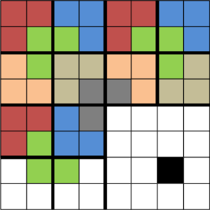
Tromino cover
Steps:
Divide the 2^{n} × 2^{n} board into 4 disjoint 2^{n−1} × 2^{n−1} subboards
Place a tromino at the center so that it fully covers one square from each of the three ( 3 ) subboards with no missing square, and misses the fourth subboard completely. This reduces the original problem into 4 smaller instances of the same problem!
Solve each smaller subproblem recursively using the same technique.
An algorithmic puzzle
Figure: Rezaul A. Chowdhury, CSE 373, 2014
23/44

Slide 27
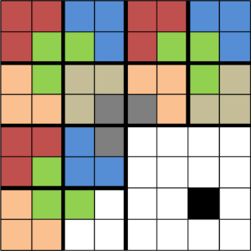
Tromino cover
Steps:
Divide the 2^{n} × 2^{n} board into 4 disjoint 2^{n−1} × 2^{n−1} subboards
Place a tromino at the center so that it fully covers one square from each of the three ( 3 ) subboards with no missing square, and misses the fourth subboard completely. This reduces the original problem into 4 smaller instances of the same problem!
Solve each smaller subproblem recursively using the same technique.
An algorithmic puzzle
Figure: Rezaul A. Chowdhury, CSE 373, 2014
24/44

Slide 28
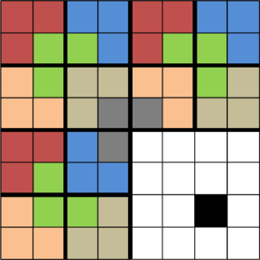
Tromino cover
Steps:
Divide the 2^{n} × 2^{n} board into 4 disjoint 2^{n−1} × 2^{n−1} subboards
Place a tromino at the center so that it fully covers one square from each of the three ( 3 ) subboards with no missing square, and misses the fourth subboard completely. This reduces the original problem into 4 smaller instances of the same problem!
Solve each smaller subproblem recursively using the same technique.
An algorithmic puzzle
Figure: Rezaul A. Chowdhury, CSE 373, 2014
25/44

Slide 29
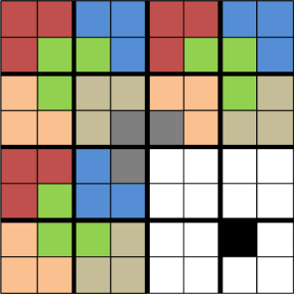
Tromino cover
Steps:
Divide the 2^{n} × 2^{n} board into 4 disjoint 2^{n−1} × 2^{n−1} subboards
Place a tromino at the center so that it fully covers one square from each of the three ( 3 ) subboards with no missing square, and misses the fourth subboard completely. This reduces the original problem into 4 smaller instances of the same problem!
Solve each smaller subproblem recursively using the same technique.
An algorithmic puzzle
Figure: Rezaul A. Chowdhury, CSE 373, 2014
26/44

Slide 30
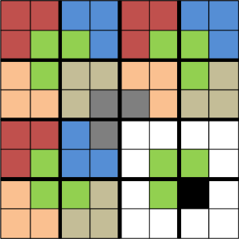
Tromino cover
Steps:
Divide the 2^{n} × 2^{n} board into 4 disjoint 2^{n−1} × 2^{n−1} subboards
Place a tromino at the center so that it fully covers one square from each of the three ( 3 ) subboards with no missing square, and misses the fourth subboard completely. This reduces the original problem into 4 smaller instances of the same problem!
Solve each smaller subproblem recursively using the same technique.
An algorithmic puzzle
Figure: Rezaul A. Chowdhury, CSE 373, 2014
27/44

Slide 31
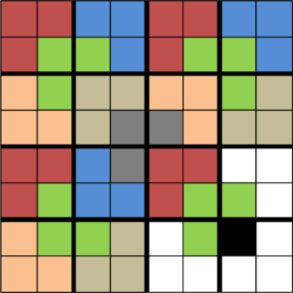
Tromino cover
Steps:
Divide the 2^{n} × 2^{n} board into 4 disjoint 2^{n−1} × 2^{n−1} subboards
Place a tromino at the center so that it fully covers one square from each of the three ( 3 ) subboards with no missing square, and misses the fourth subboard completely. This reduces the original problem into 4 smaller instances of the same problem!
Solve each smaller subproblem recursively using the same technique.
An algorithmic puzzle
Figure: Rezaul A. Chowdhury, CSE 373, 2014
28/44

Slide 32
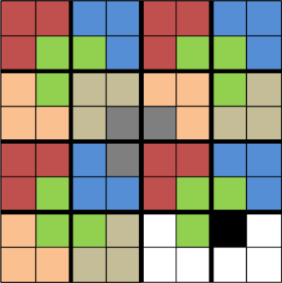
Tromino cover
Steps:
Divide the 2^{n} × 2^{n} board into 4 disjoint 2^{n−1} × 2^{n−1} subboards
Place a tromino at the center so that it fully covers one square from each of the three ( 3 ) subboards with no missing square, and misses the fourth subboard completely. This reduces the original problem into 4 smaller instances of the same problem!
Solve each smaller subproblem recursively using the same technique.
An algorithmic puzzle
Figure: Rezaul A. Chowdhury, CSE 373, 2014
29/44

Slide 33
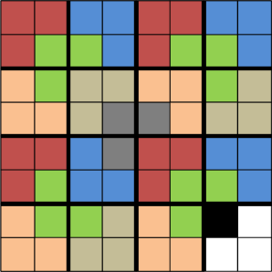
Tromino cover
Steps:
Divide the 2^{n} × 2^{n} board into 4 disjoint 2^{n−1} × 2^{n−1} subboards
Place a tromino at the center so that it fully covers one square from each of the three ( 3 ) subboards with no missing square, and misses the fourth subboard completely. This reduces the original problem into 4 smaller instances of the same problem!
Solve each smaller subproblem recursively using the same technique.
An algorithmic puzzle
Figure: Rezaul A. Chowdhury, CSE 373, 2014
30/44

Slide 34
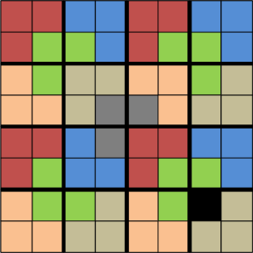
Tromino cover
Steps:
Divide the 2^{n} × 2^{n} board into 4 disjoint 2^{n−1} × 2^{n−1} subboards
Place a tromino at the center so that it fully covers one square from each of the three ( 3 ) subboards with no missing square, and misses the fourth subboard completely. This reduces the original problem into 4 smaller instances of the same problem!
Solve each smaller subproblem recursively using the same technique.
Figure: Rezaul A. Chowdhury, CSE 373, 2014
An algorithmic puzzle
31/44

Slide 35
What is Recursion
Every recursive definition has 2 parts:
BASE CASE(S): so simple that they can be solved directly
RECURSIVE CASE(S): make use of recursion to solve smaller subproblems and combine into a solution to the larger problem
Base Case: One or more conditions based on which the function will stop the recursive call. (Stopping condition)
Recursive Case: The function calling itself within its definition.
Recursion

Slide 36
Factorial
1
n * (n-1)!
if n = 0
if n > 0
n! =
5! = 5*4*3*2*1
4! = 4*3*2*1
3! = 3*2*1
2! = 2*1
1! = 1
0! = 1
5! = 5*4!
4! = 4*3!
3! = 3*2!
2! = 2*1!
1! = 1
0! = 1
Recursion

Slide 37
Recursion vs. While Loop
🔁 Recursion vs. While Loop
Recursion is often an alternative to a while loop.
You usually don’t use recursion and a while loop together — they solve the same kind of problems.
Loop Concept | Recursion Equivalent
Loop condition | Opposite becomes base case
Loop body | Recursive case
Recursion

Slide 38
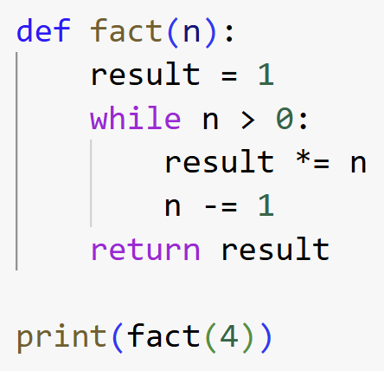
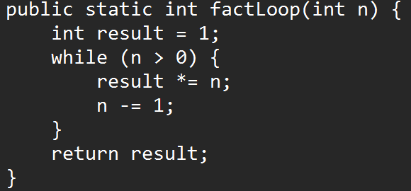
Factorial
1
n * (n-1)!
if n = 0
if n > 0
n! =
Iterative
Iterative
Recursive
Recursion

Slide 39
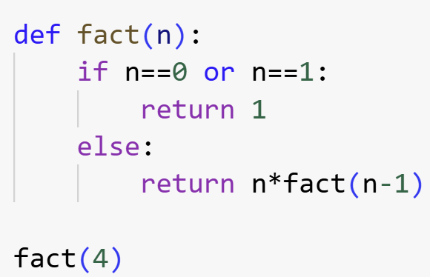
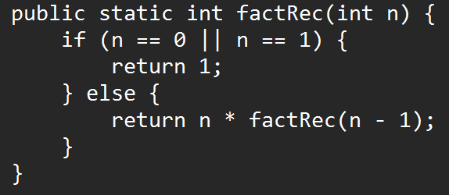
Factorial
1
n * (n-1)!
if n = 0
if n > 0
n! =
Recursive
Iterative
Iterative
Recursion

Slide 40
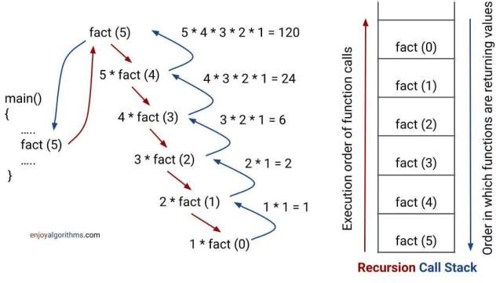
Factorial
1
n* (n-1)!
if n = 0
if n > 0
n! =
Recursive
Sourse; https://www.enjoyalgorithms.com/blog/recursion-explained-how-recursion-works-in-programming
Recursion

Slide 41
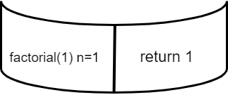
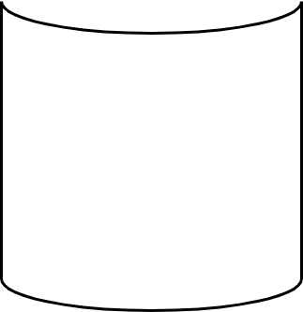
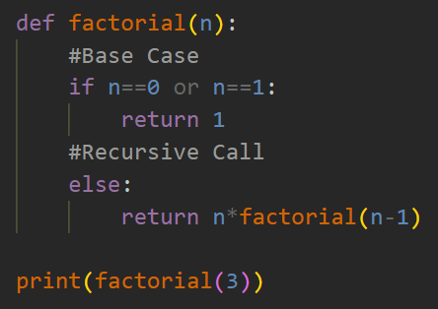
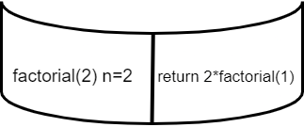
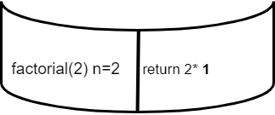
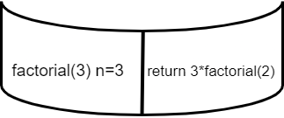
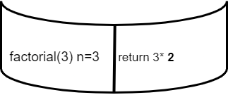
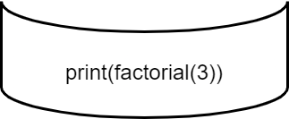
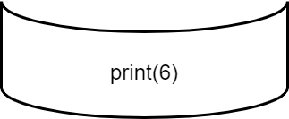
The Call Stack
Output: 6

Slide 42
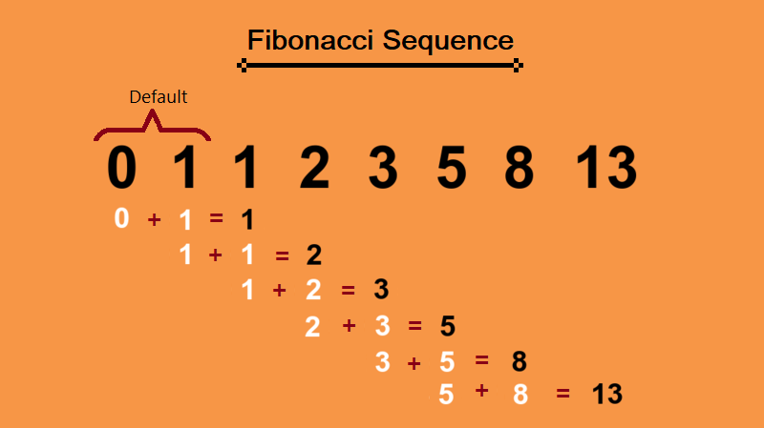
Fibonacci
^{Fib(n) =}
0 if n = 0
1 if n = 1
Fib(n–1) + Fib(n–2) if n > 1
Recursion

Slide 43
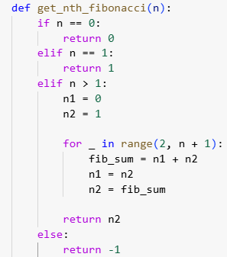
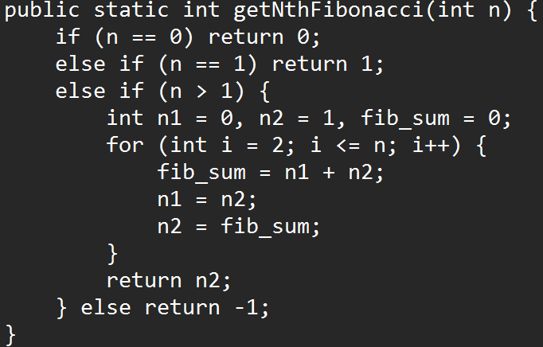
Fibonacci
^{Fib(n) =}
0 if n = 0
1 if n = 1
Iterative
Fib(n–1) + Fib(n–2) if n > 1
Recursion

Slide 44
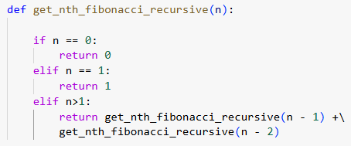
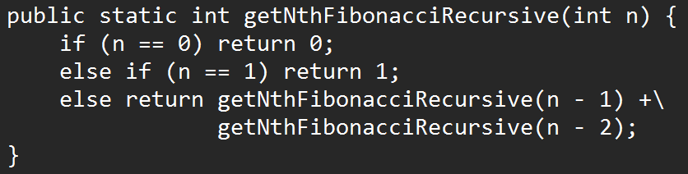
Fibonacci
^{Fib(n) =}
0 if n = 0
1 if n = 1
Fib(n–1) + Fib(n–2) if n > 1
Iterative
Recursive
Recursion

Slide 45
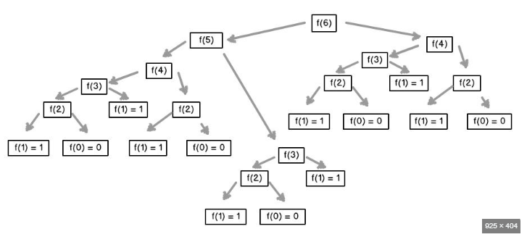
Fibonacci
^{Fib(n) =}
0 if n = 0
1 if n = 1
Fib(n–1) + Fib(n–2) if n > 1
Source: https://www.idc-online.com/technical_references/pdfs/information_technology/Tree_Recursion_in_Python.pdf
Recursion

Slide 46
Iterative vs recursive solutions
Find the tallest person in a group of N > 0 students
Recursion

Slide 47
Iterative vs recursive solutions
Find the tallest person in a group of N > 0 students
Iterative??
Recursion

Slide 48
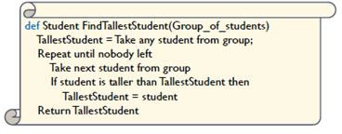
Iterative vs recursive solutions
Find the tallest person in a group of N > 0 students
Iterative
Recursion

Slide 49
Iterative vs recursive solutions
Find the tallest person in a group of N > 0 students
Iterative
Recursive ??
Recursion

Slide 50

Iterative vs recursive solutions
Find the tallest person in a group of N > 0 students
Iterative
Recursive
Recursion

Slide 51
References
Brad Miller and David Ranum, Problem Solving with Algorithms and Data Structures, Release 3, 2013
Object Oriented Programming

